Slide 1
When doe hypercapnia cause hypoxemia in SLC?
Brian Locke, MD
Pulmonary and Critical Care Fellow

Slide 2
Remember, hypercapnia in general is PaCO2 over 45 mmHg. However, at SLC elevation a PaCO2 of 42 mmHg has the same prognostic significance due to altitude induced hyperventilation.
More on this later.

Slide 3
Standard Equation, explained
PA_{O2} = Pi_{O2}* – (Pa_{CO2} / RQ)
Pi_{O2}* = represents O2 arriving at the alveoli, which becomes saturated with H₂O through the airways
Pi_{O2}* = (P_{atm} – P_{H2O}) * Fi_{O2}, P_{H2O} taken to be 47, but varies w/ Temp
Pa_{CO2} / RQ represents the volume of O₂ in the alveoli removed into the blood

Slide 4
Standard Equation, assumptions
PA_{O2} = (P_{atm} – P_{H2O}) * Fi_{O2} – (Pa_{CO2} / RQ)
Gases obey Dalton’s Law – Total pressure equals the sum of all the partial pressures (P_{Atm} = P_{N2} + P_{O2} + P_{CO2} + P_{H2O}). Not quite true but close
Alveolar Gases are completely saturated with water vapor. True
CO₂ in Alveoli is in equilibrium with CO2 in in pulmonary capillaries: PA_{CO2} = Pa_{CO2}. Essentially always true
Inspired gas contains no CO₂. Not quite true but close if breathing atm air
Amount of gas inspired/utilized is equal to amount of gas expired/created by metabolism (e.g. RQ = 1) – not true, but close in most circumstances.
Addressed by complete equation on next slide

Slide 5
Extended Equation Justification
PA_{O2} = (P_{atm} – P_{H2O}) * Fi_{O2} – (Pa_{CO2} / RQ)
(P_{atm} – P_{H2O}) * Fi_{O2} = represents O2 arriving at the alveoli, which becomes saturated with H₂O through the airways
Pa_{CO2} / RQ represents the volume of O2 in the alveoli removed into the blood
However: if RQ =/= 1, we know that every O₂ molecule leaving the alveoli is NOT replaced by 1 molecule of CO₂.
E.g. RQ = 0.8, VO₂ might be 0.25 L/min, VCO₂ might be 0.20 L/min
Thus, at steady state – 0.05 L/min must passively diffuse into the alveoli

Slide 6
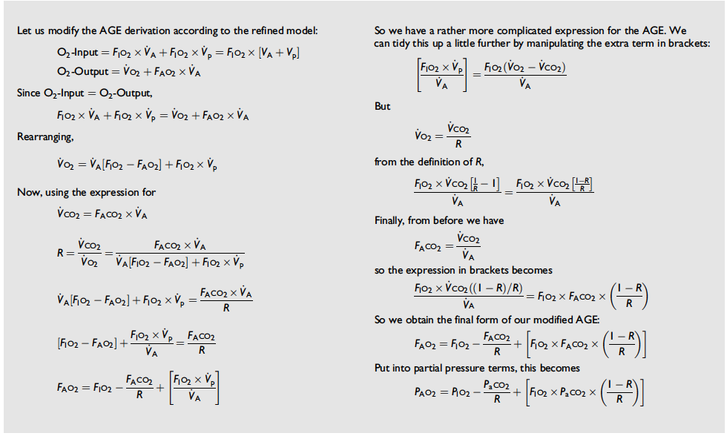
Extended Equation Justification
However: if RQ =/= 1, we know that every O2 molecule leaving the alveoli is NOT replaced by 1 molecule of CO2.
V_{p} (passive) = |VO₂ – VCO₂|
DOI 10.1093/bjaceaccp/mkh008

Slide 7
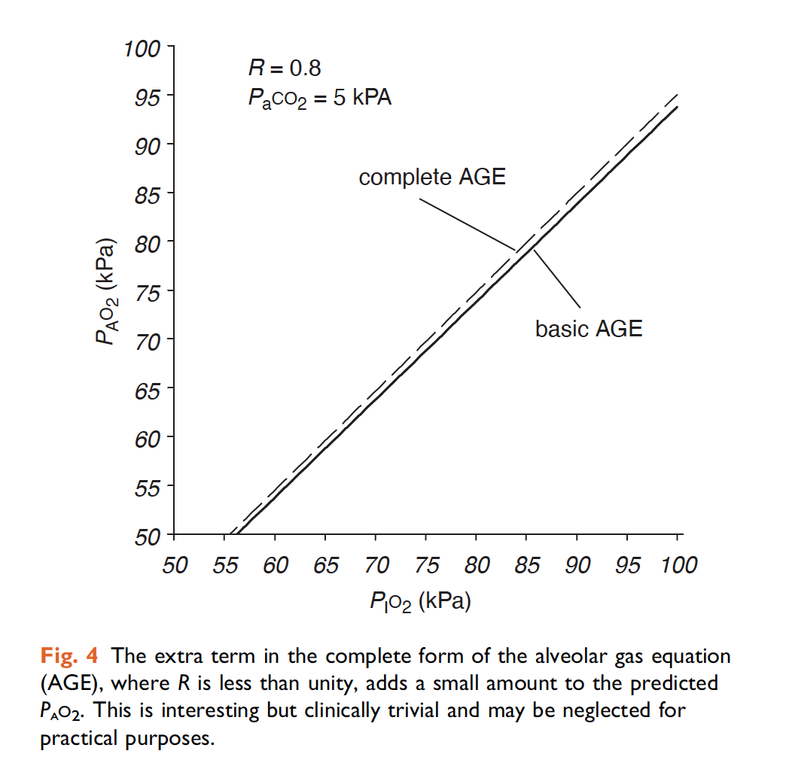
Extended Equation Justification
However: if RQ =/= 1, we know that every O2 molecule leaving the alveoli is NOT replaced by 1 molecule of CO2.
V_{p} (passive) = |VO2 – VCO2|
When Fi_{O2} * (1-RQ) is much less than 1, this term is small and can be safely ignored.
DOI 10.1093/bjaceaccp/mkh008

Slide 8
Extended Equation, Explained
PA_{O2} = (P_{atm} – P_{H2O}) * Fi_{O2} – (Pa_{CO2} / RQ) + Fi_{O2} * Pa_{CO2} * (1-RQ)/RQ
(P_{atm} – P_{H2O}) * Fi_{O2} = represents O2 arriving at the alveoli, which becomes saturated with H2O through the airways
Pa_{CO2} / RQ represents the volume of O2 in the alveoli removed into the blood
Fi_{O2} * Pa_{CO2} * (1-RQ)/RQ represents the passive flow that must occur to maintain steady state when RQ =/= 1, because every O₂ molecule leaving the alveoli is NOT replaced by 1 molecule of CO₂.

Slide 9
SLC Average values
PA_{O2} = (P_{atm} – P_{H2O}) * Fi_{O2} – (Pa_{CO2} / RQ) + Fi_{O2} * Pa_{CO2} * (1-RQ)/RQ
PA_{O2} = (650 – 47) * 0.21 – (Pa_{CO2} / 0.8) + 0.21 * Pa_{CO2} * (1-0.8)/0.8
PA_{O2} = 126.63 – (Pa_{CO2} / 0.8) + 0.05 * Pa_{CO2}
PA_{O2} = 126.63 – 1.3 * Pa_{CO2}
Notes:
Sea level:
(760 – 47) * .21 =

Slide 10
When is hypoxemia noticeable?
SpO2 <90% catches people’s attention
Corresponds to a PaO2 of ~55 mmHg (depending exactly on the individual’s oxygen hemoglobin dissociation curve.
Normal A-a gradient? 4 + (0.25 * Age)
Critical PAO2 = paO2 + (A-a gradient)
Critical PAO2 = 51 + 0.25 * Age
Notes:
https://onlinelibrary.wiley.com/doi/10.1111/j.1748-1716.1966.tb03281.x
https://www.atsjournals.org/doi/10.1164/arrd.1968.97.3.376?url_ver=Z39.88-2003&rfr_id=ori%3Arid%3Acrossref.org&rfr_dat=cr_pub++0pubmed&

Slide 11
Empirical measures: Crapo et al.
PaO2 by age:
-0.25 mmHg / yr
Notes:
https://citeseerx.ist.psu.edu/viewdoc/download?doi=10.1.1.315.523&rep=rep1&type=pdf
“The decline in PaO2 with age in our study (-0.245 mm Hg/yr) is consistent with the studies of Raine and Bishop (2) (-0.24 mm Hg/yr), Conway and colleagues (4) (-0.22 mm Hg/yr), Marshall and Millar (5) (-0.25 mm Hg/yr), and Mellemgaard

Slide 12
Critical PaCO2 with normal A-a gradient?
Combining critical PAO2 with expected PAO2 by CO2:
51 + (0.25 * Age) = 126.63 – 1.3 * Pa_{CO2}
75.63 - 0.25*Age = 1.3 * PaCO2
58.17 - .19 * Age = PaCO2
For someone who is 60?
Pa_{CO2} = 46.77 mmHg
Notes:
Crapo et al
(PaO2 = 0.1834 PB - 0.2452 * age - 31.453)
PaO2 = 0.1834 * 647 - 0.2452 * age - 31.453)
paO2 = 85.01 – 0.2452 * Age

Slide 13
Comparison: at sea level
Sea level:
PA_{O2} = 149.73 – 1.3 * Pa_{CO2}
51 + (0.25 * Age) = 149.73 – 1.3 * Pa_{CO2}
75.95 - .19 * Age = PaCO2

Slide 15
How elevation plays in to this
pAtm = 760 * e^{(Elevation/-7000)}
Expected PaCO2 by elevation?

Slide 16
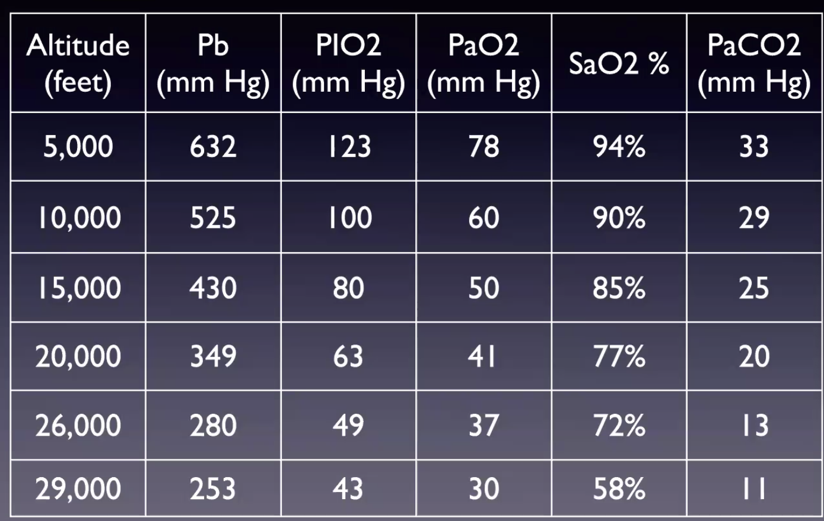
Expected compensation (From Grissom)
Notes:
[ ]. Adjust for this

